Slide 1

Actirate – Actibelt Heart Rate Sensor
We are trying to get the raw data from the Actibelt LED HR sensor and trying to extract the actual heart rate.

Slide 2
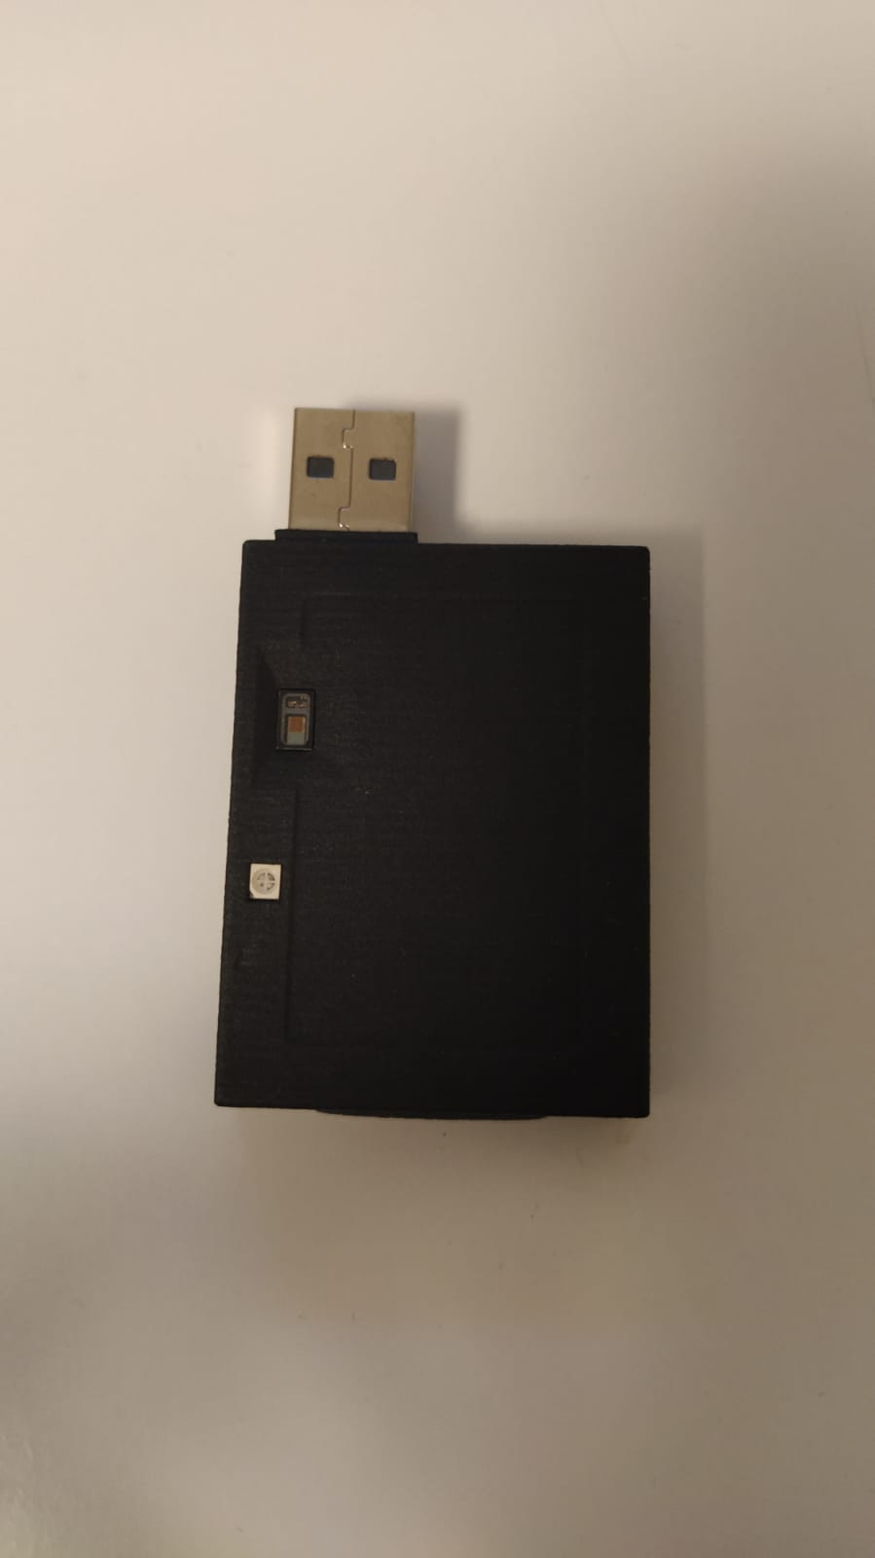
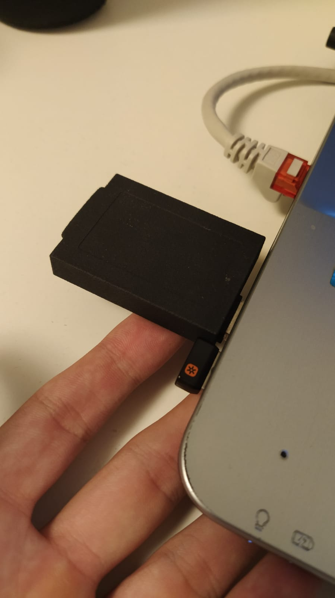
Actibelt has a LED HR sensor
Sensor measures HR from the finger tip.

Slide 3
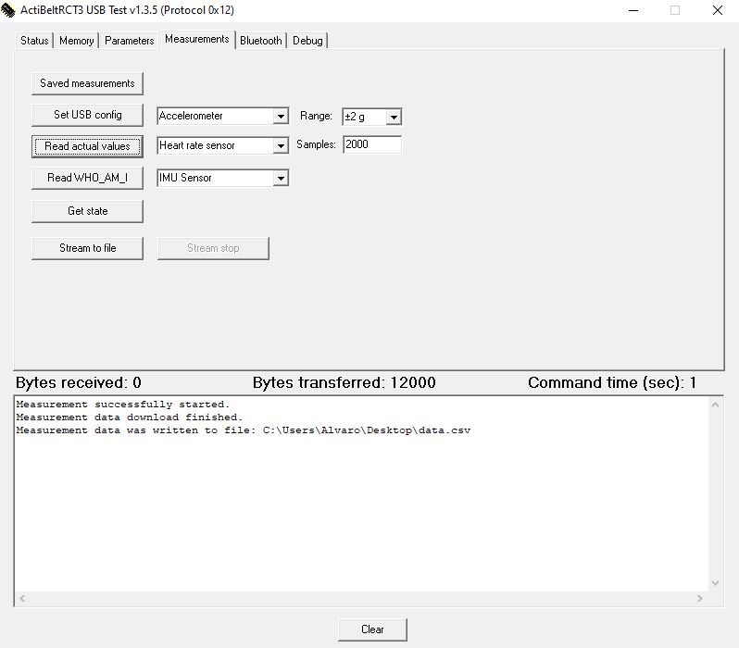

Slide 4
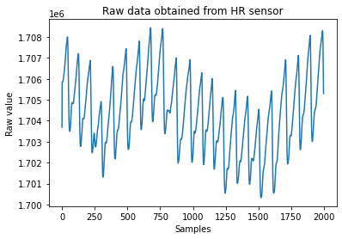

Slide 5
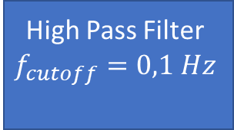
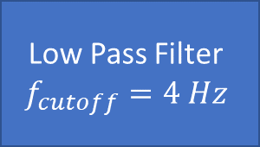


Pipeline
Actibelt HR Sensor
Rawdata
Low Pass Filter
$$f_{cutoff}=4 Hz$$
High Pass Filter
$$f_{cutoff}=0,1 Hz$$
Filtered signal
FFT
$$arg\max_{f}{FFT}⁡$$
$$f_{HR}$$

Slide 6
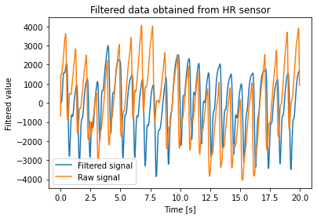
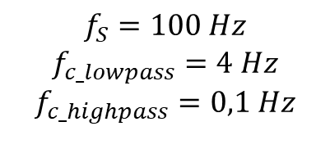
$$f_{S}=100 Hz$$
$$f_{c_lowpass}=4 Hz$$
$$f_{c_highpass}=0,1 Hz$$

Slide 7
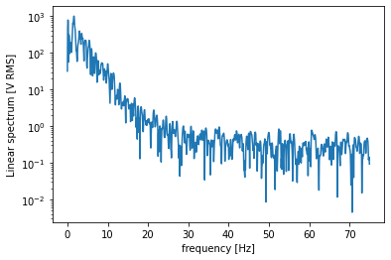
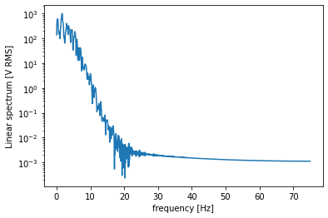
Frequency Domain
Raw signal
Filtered signal

Slide 8
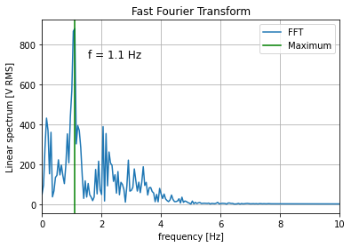

Fast Fourier Transform
$$f_{max}{=1,1 Hz ⇒HR=1,1 ∗60=66 BPM}$$

